Slide 1




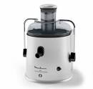



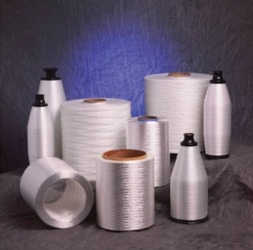
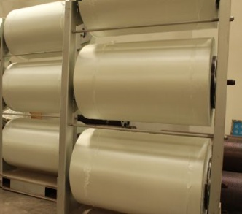
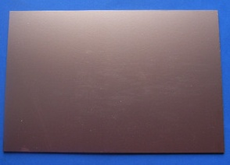
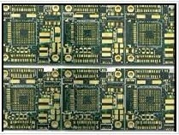
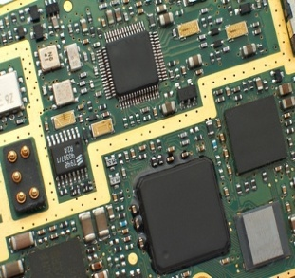
PCB Value Chain related to Composites business
Various electronics devices
What is PCB?
Printed Circuit Board. Fundament of electronics!!
 | E-Glass yarn producers | Glass cloth fabricators (customers) | Copper clad laminate producers | PCB board producers | PCB assemblers

Slide 2
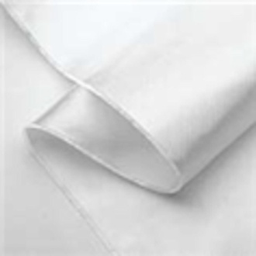
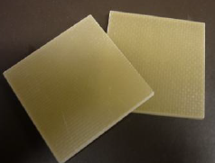

Manufacturing Process of PCB
E-Glass cloth
Resin
Impregnation
Copper Clad
Laminate
Glass as reinforcement
7628 (thick cloth)
2116 (thin cloth)
1080 (thin cloth)
106 (thin cloth)
Others
Resin as matrix
FR-4 (standard Epoxy)
FR-5 (High strength Epoxy)
BT
Polyimides
Others
Copper as conductive layer

Slide 3
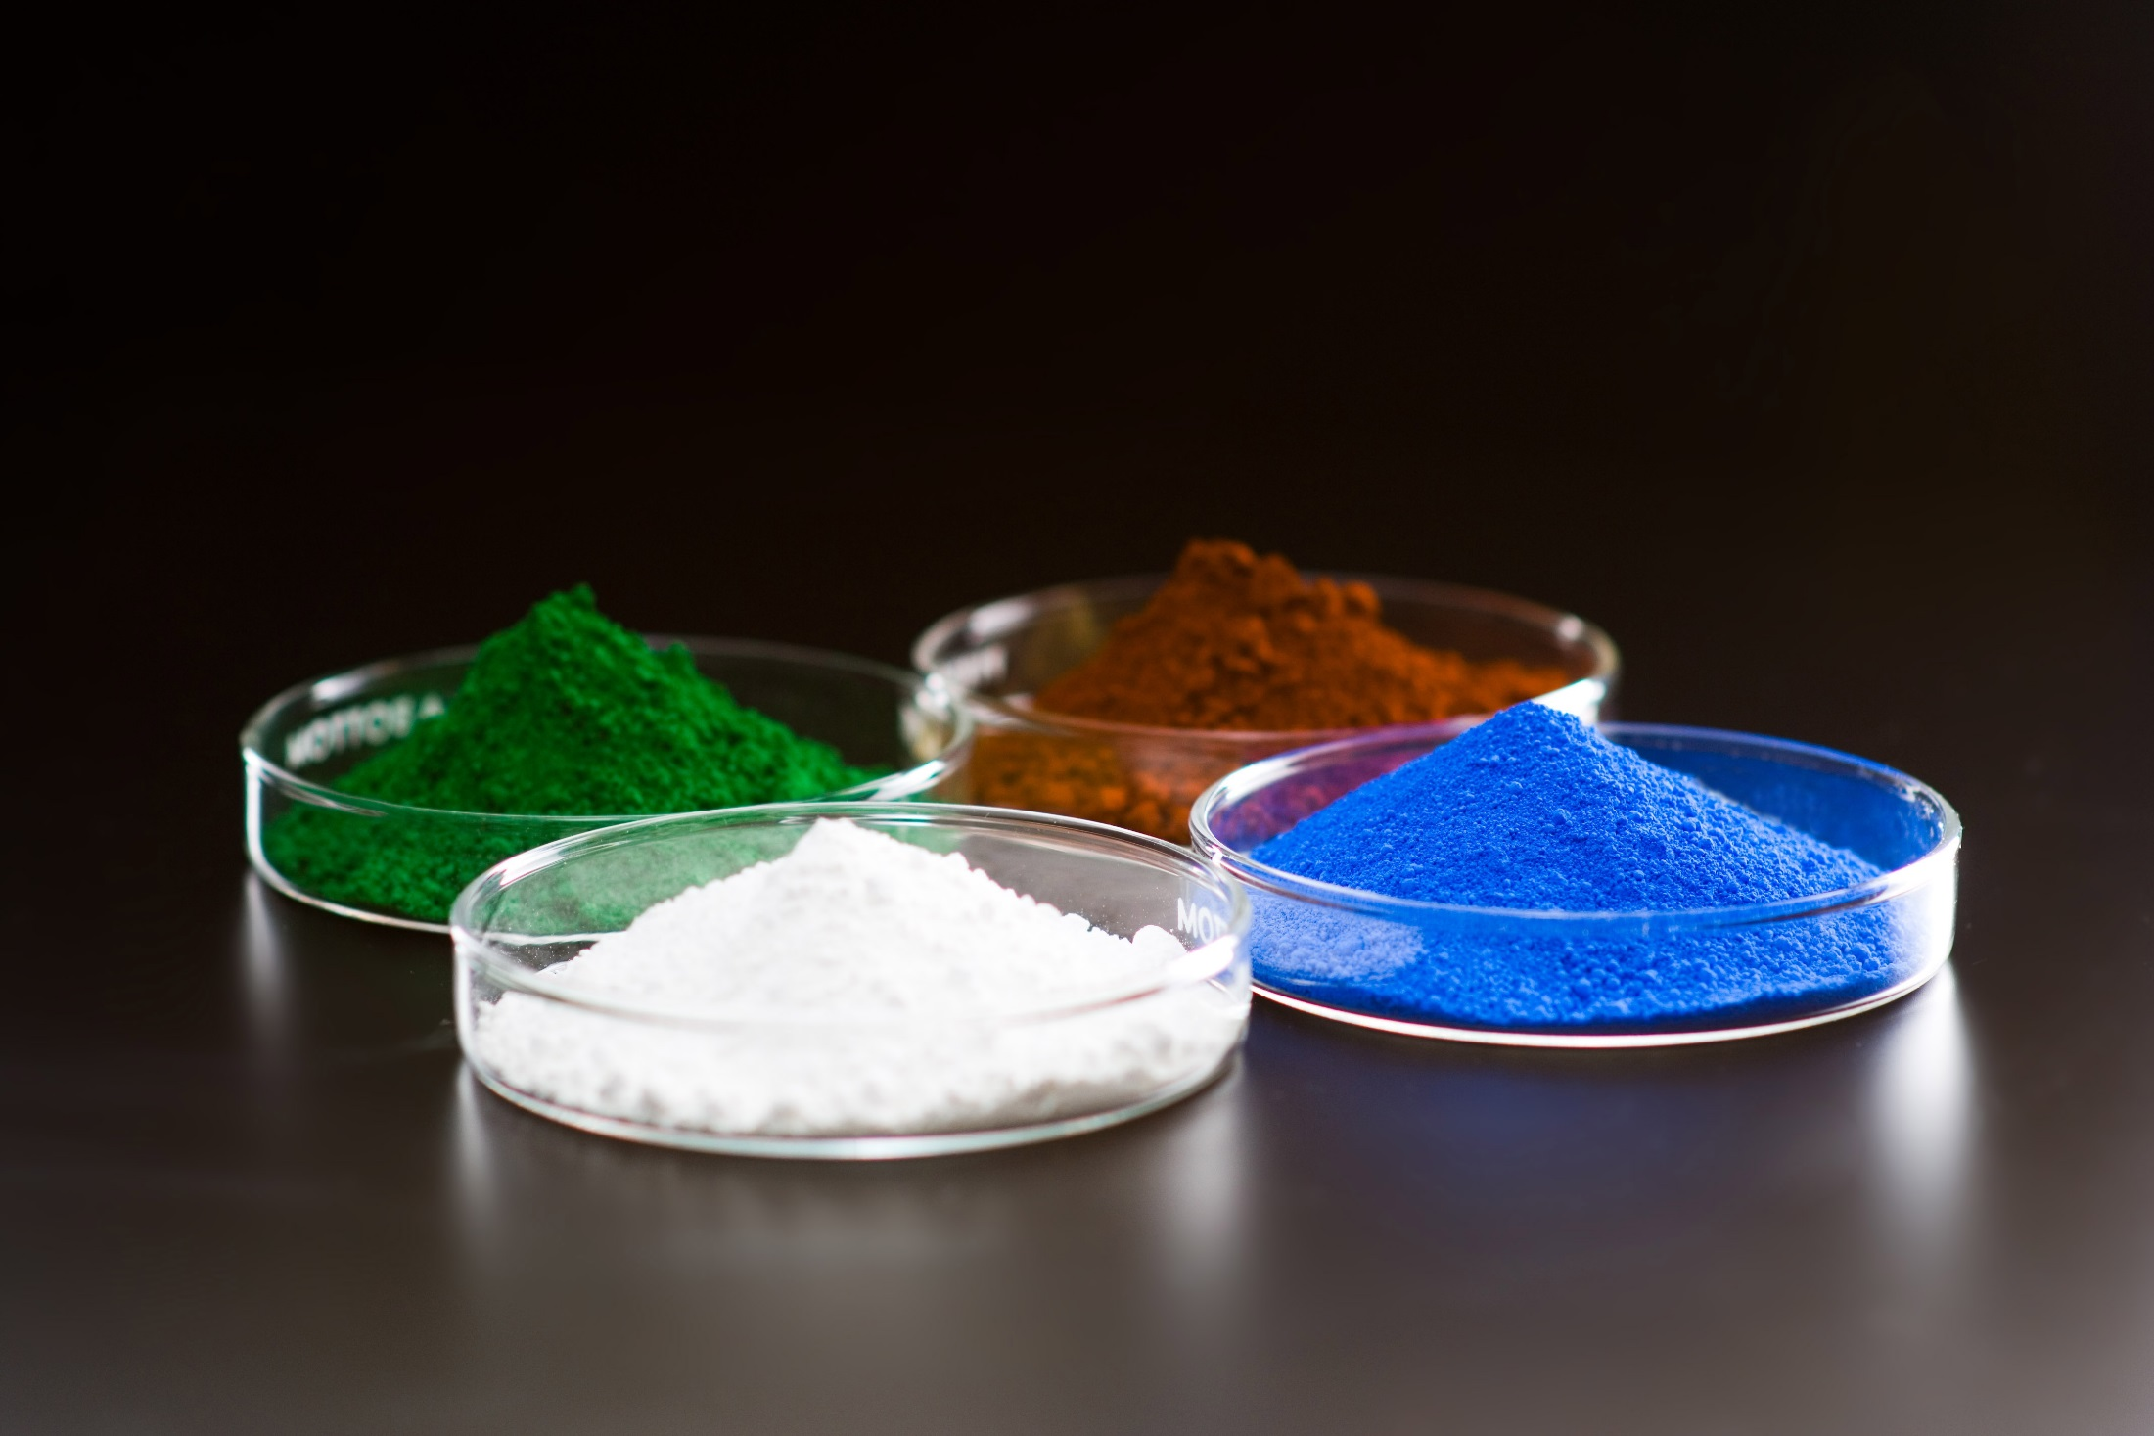
Dow Corning Filler Dispersion Aid
for the Plastics/Rubber Industry
道康宁填料分散助剂在塑料橡胶工业的应用
Scott E. Miller and Helen He, Technical Service
Materials Reinforcement- Industry Specialists
Dow Corning Corporation

Slide 4
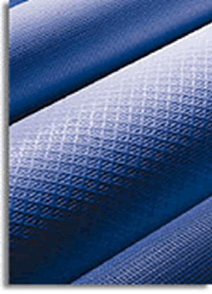
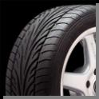
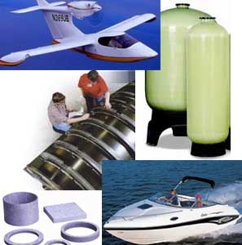


What Properties Can Silanes Influence?
硅烷能提高哪些性能?
Coupling Agent / Adhesion Promoter 偶联剂，粘合促进剂
  Coupling between inorganic materials
  and organic polymers 无机和有机材料之间的偶联
  Improved adhesion between
  surfaces and polymers 提高表面和聚合物之间的粘合
Crosslinking 交联
Other applications 其他应用
  Moisture Scavenging 屏蔽潮湿
  Blocking Agent 封端剂
  Silicate Stabilization 对硅酸盐稳定作用
Dispersing / Hydrophobing Agent 分散/疏水剂
  Improved filler and pigment dispersion 提高填料和颜料的分散
  Improved mechanical/optical/electrical properties 改善机械/光学/电性能
  Improved cure/less cure inhibition 促进固化/减少固化阻力

Slide 5
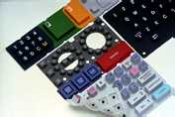
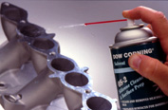


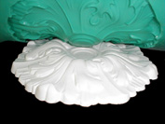



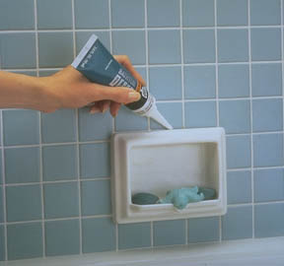
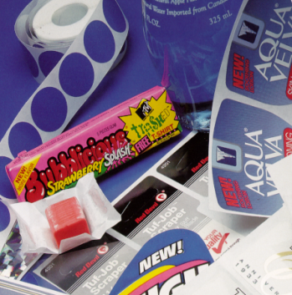

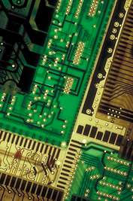
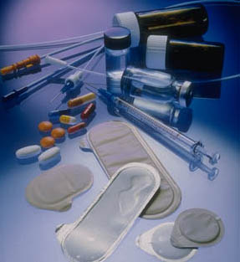
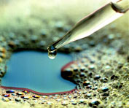
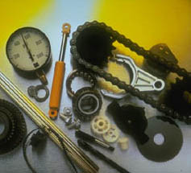
Some Product Applications…
Office Equipment
Maintenance
Consumer goods
Insulator materials
Mold Making
Automotive
Personal Care
Textile
Construction
Pressure Sensitive
Aerospace
Antifoams
Electronics
Health Care
Lubrication

Slide 6
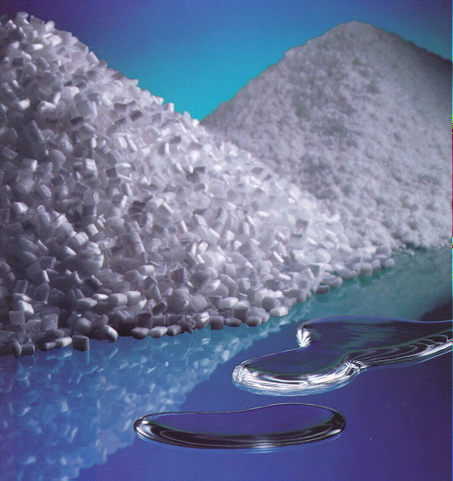
固體 - 液體
Si-Powder 系列
粉狀產品
MB 系列
粒狀產品
200 fluids 系列
液狀產品

Slide 7
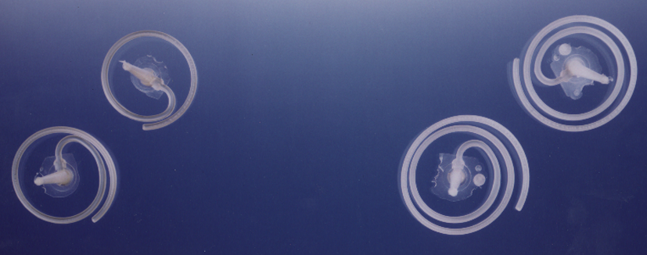

Processing Aide
Injection molding
  reduced cycle time
  reduced operating temperature
Pigmented PP Homopolymer
Pigmented PP Homopolymer
Pigmented PP Homopolymer
Pigmented PP Homopolymer
without Siloxane Additive
without Siloxane Additive
with 0.4% of
with 0.4% of
MB50 001
MB50 001
A Dow Corning Company

Slide 8
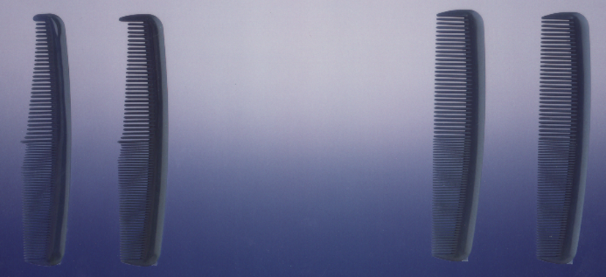
Processing Aide
Injection molding
  better mould filling
  improved mold release
Pigmented PP Homopolymer
Pigmented PP Homopolymer
Pigmented PP Homopolymer
Pigmented PP Homopolymer
without Siloxane Additive
without Siloxane Additive
with 0.4% of
with 0.4% of
MB50 001
MB50 001
Injection Temperature: 190 ºC
Injection Temperature: 190 ºC
A Dow Corning Company

Slide 9
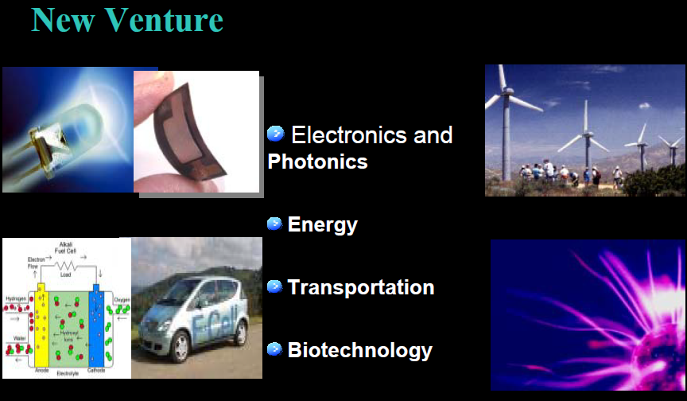

Slide 10
航天工業 :
耐燒蝕材料
黏著劑 / 密封件
塗料
汽車工業 :
黏著劑 / 硅橡膠
密封膠
潤滑劑

Slide 11
石油 / 化學工業 :
添加劑
偶合劑
高溫塗料
塑膠工業 :
離型劑
固態硅改質劑
催化劑給電子體

Slide 12
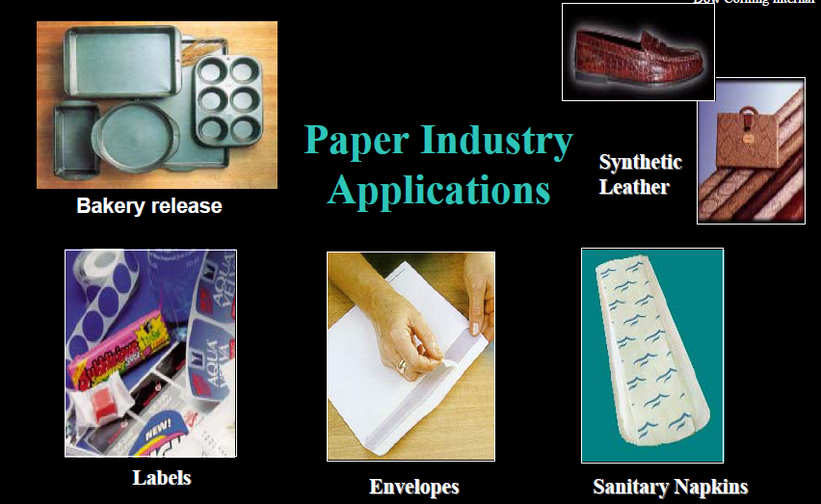

Slide 13
